Slide 1
Virtual Memory
Demand Paging
Page Replacement Algorithms
Thrashing

Slide 2
The Content is prepared with the help of existing text books mentioned below:
References:
Silberschatz, Abraham, Peter B. Galvin, and Greg Gagne. Operating system concepts with Java. Wiley Publishing, 2009.
Stallings, William. Operating Systems 5th Edition. Pearson Education India, 2006.
Tannenbaum, Andrew S. "Modern Operating Systems, 2009."

Slide 3
Objectives
To describe the benefits of a virtual memory system
To explain the concepts of demand paging, page-replacement algorithms, allocation of page frames and thrashing.
To discuss the principle of the working-set model

Slide 4
Background
In practice, most real processes do not need all their pages, or at least not all at once, for several reasons:
Arrays are often over-sized
Certain features of programs are rarely used.
The ability to load only the portions of processes that were actually needed has several benefits:
Programs could be written for a much larger address space.
more memory left for other programs, improving CPU utilization and system throughput.
Less I/O is needed for swapping processes in and out of RAM, speeding things up.

Slide 5
Background
Virtual memory – separation of user logical memory from physical memory.
Only part of the program needs to be in memory for execution
Logical address space can therefore be much larger than physical address space
Allows address spaces to be shared by several processes
Allows for more efficient process creation
Virtual memory can be implemented via:
Demand paging
Demand segmentation

Slide 6
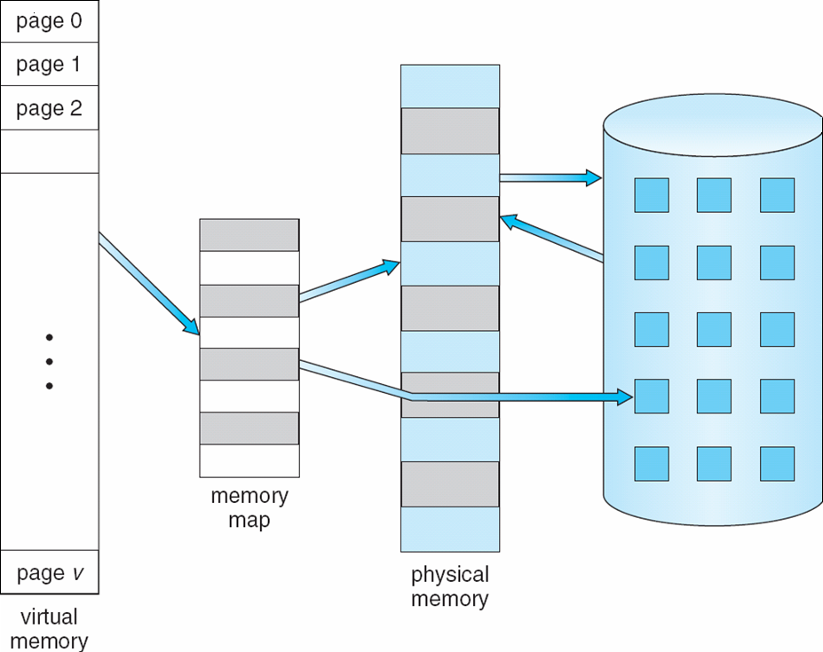
Virtual Memory That is Larger Than Physical Memory
⇒

Slide 7
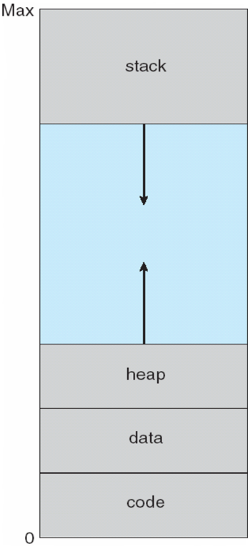
Virtual-address Space
Note that the address space shown in Figure is sparse - A great hole in the middle of the address space is never used, unless the stack and/or the heap grow to fill the hole.

Slide 8
Shared Library Using Virtual Memory
Virtual memory also allows the sharing of files and memory by multiple processes, with several benefits:
System libraries can be shared by more than one process.
Processes can also share virtual memory by mapping the same block of memory to more than one process.
Process pages can be shared during a fork( ) system call, eliminating the need to copy all of the pages of the original ( parent ) process.

Slide 9
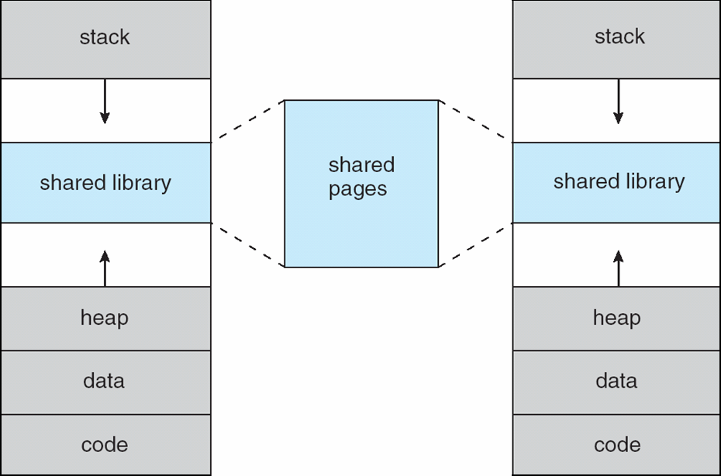
Shared Library Using Virtual Memory

Slide 10
Demand Paging
Bring a page into memory only when it is needed
Less I/O needed
Less memory needed
Faster response
More users
Page is needed ⇒ reference to it
invalid reference ⇒ abort
not-in-memory ⇒ bring to memory
Lazy swapper – never swaps a page into memory unless page will be needed
Swapper that deals with pages is a pager

Slide 11
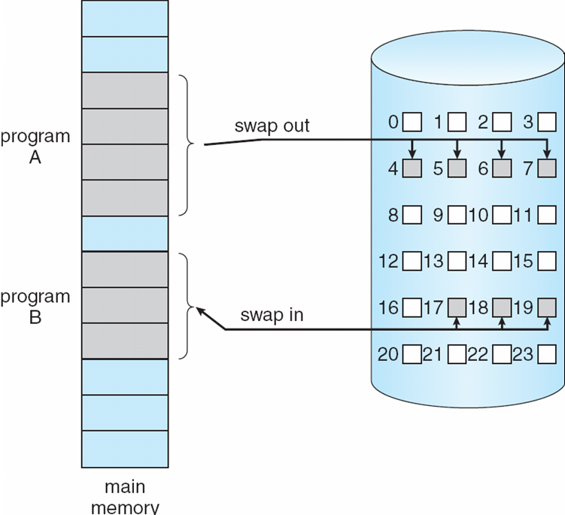
Transfer of a Paged Memory to Contiguous Disk Space

Slide 12
Demand Paging Basic Concepts
The basic idea behind paging is that when a process is swapped in, the pager only loads into memory those pages that it expects the process to need ( right away)
Pages that are not loaded into memory are marked as invalid in the page table, using the invalid bit.
If the process only ever accesses memory resident pages, then the process runs exactly as if all the pages were loaded in to memory.

Slide 13
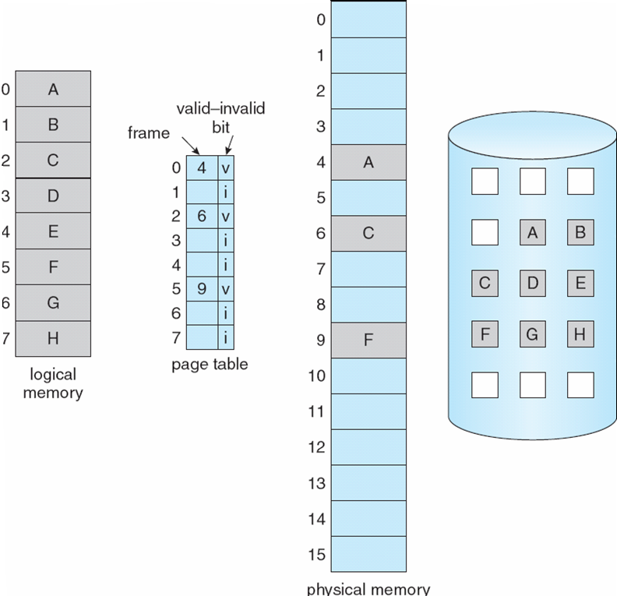
Page Table When Some Pages Are Not in Main Memory

Slide 14
What is Page Fault?
The memory address requested is first checked, to make sure it was a valid memory request . If the page is not in memory (invalid bit is set)than it results in page fault. Also If there is a reference to a page, first reference to that page will trap to operating system causing page fault

Slide 15
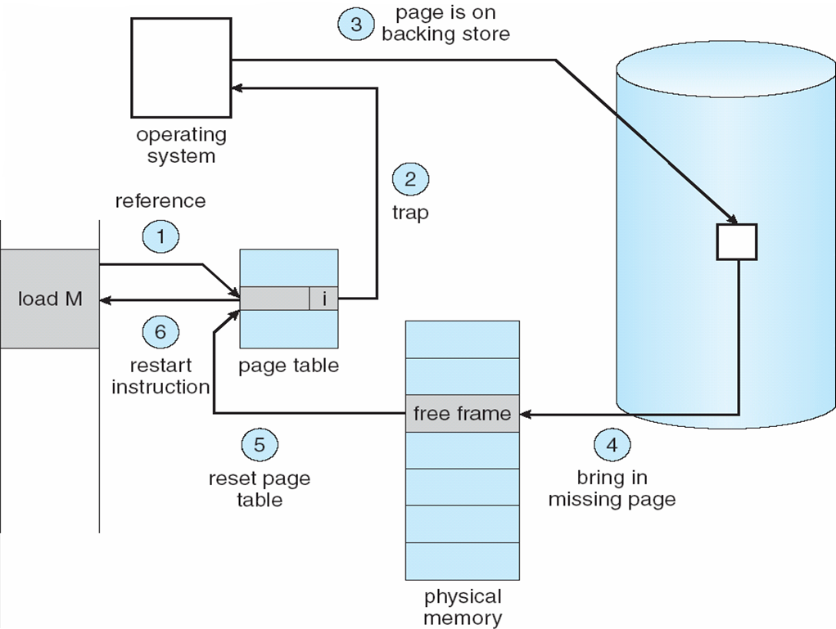
Steps in Handling a Page Fault

Slide 16
A page fault causes the following sequence to occur:
Trap to the operating system.
Save the user registers and process state.
Determine that the interrupt was a page fault.
Check that the page reference was legal and determine the location of the page on the disk
Issue a read from the disk to a free frame:
Wait in a queue for this device until the read request is serviced.
Wait for the device seek and/ or latency time.
Begin the transfer of the page to a free frame.
While waiting, allocate the CPU to some other user (CPU scheduling, optional).
Receive an interrupt from the disk I/0 subsystem (I/0 completed).
Save the registers and process state for the other user (if step 6 is executed).
Determine that the interrupt was from the disk
Correct the page table and other tables to show that the desired page is now in memory.
Wait for the CPU to be allocated to this process again.
Restore the user registers, process state, and new page table, and then resume the interrupted instruction.

Slide 17
Performance of Demand Paging
Page Fault Rate 0 ≤ p ≤ 1.0
if p = 0 no page faults
if p = 1, every reference is a fault
Effective Access Time (EAT) for each reference
EAT = (1 – p) x memory access
+ p (page fault overhead
+ swap page out
+ swap page in
+ restart overhead )

Slide 18
Demand Paging Example
Memory access time = 200 nanoseconds
Average page-fault service time = 8 milliseconds
EAT = (1 – p) x 200 + p (8 milliseconds)
= (1 – p ) x 200 + p x 8,000,000
= 200 + p x 7,999,800
If one access out of 1,000 causes a page fault, then
EAT = 8.2 microseconds.
This is a slowdown by a factor of 40!!

Slide 19
Copy-on-Write
Copy-on-Write (COW) allows both parent and child processes to initially share the same pages in memory. If either process modifies a shared page, only then is the page copied
COW allows more efficient process creation as only modified pages are copied
Free pages are allocated from a pool of zeroed-out pages

Slide 20
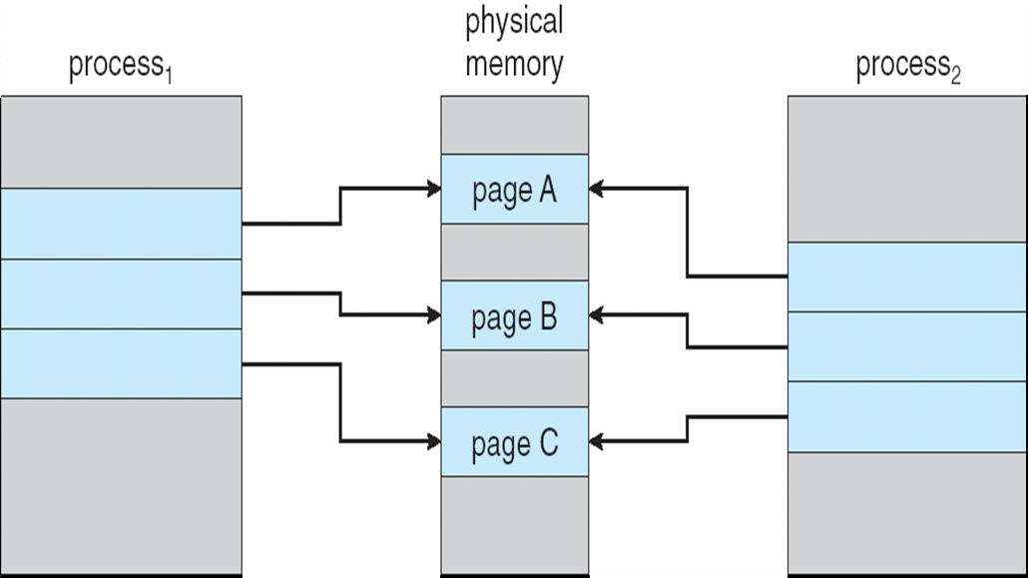
Before Process 1 Modifies Page C

Slide 21
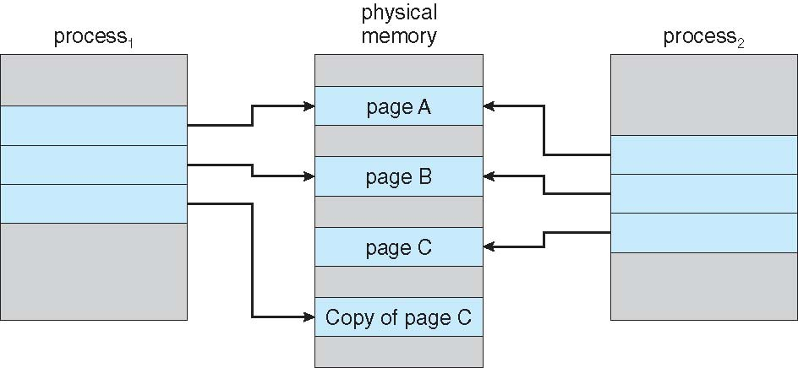
After Process 1 Modifies Page C

Slide 22
What happens if there is no free frame?
Page replacement – find some page in memory, but not really in use, swap it out
algorithm
performance – want an algorithm which will result in minimum number of page faults
Same page may be brought into memory several times

Slide 23
Page Replacement
Prevent over-allocation of memory by modifying page-fault service routine to include page replacement
Use modify (dirty) bit to reduce overhead of page transfers – only modified pages are written to disk
Page replacement completes separation between logical memory and physical memory – large virtual memory can be provided on a smaller physical memory

Slide 24
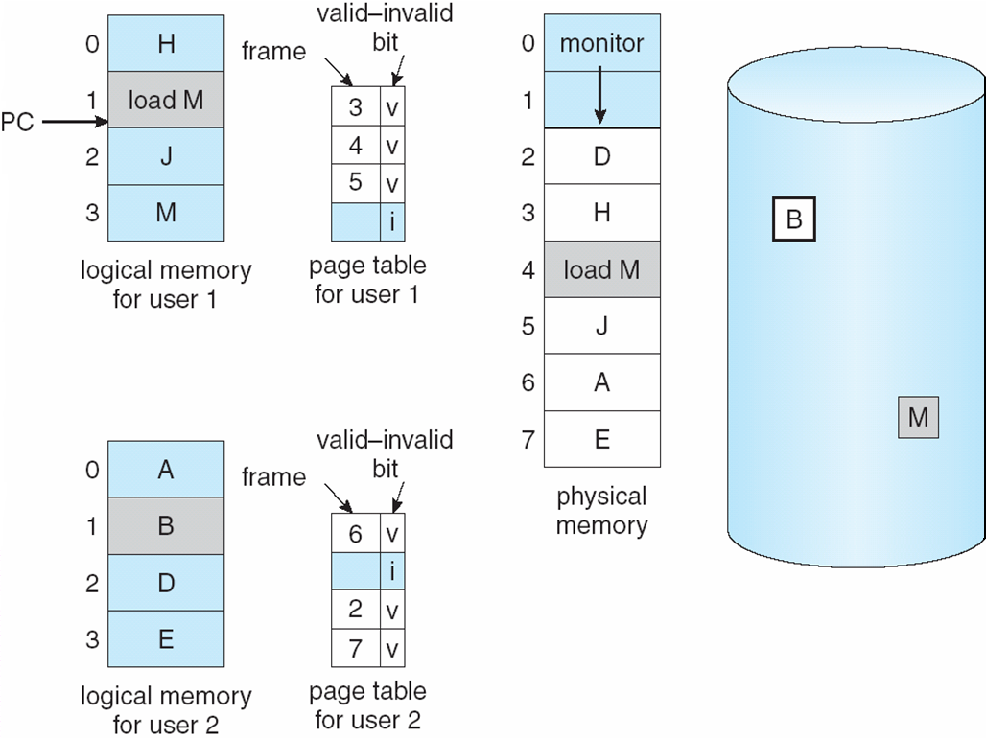
Need For Page Replacement

Slide 25
Basic Page Replacement
Find the location of the desired page on disk
Find a free frame: - If there is a free frame, use it - If there is no free frame, use a page replacement algorithm to select a victim frame
Bring the desired page into the (newly) free frame; update the page and frame tables
Restart the process

Slide 26
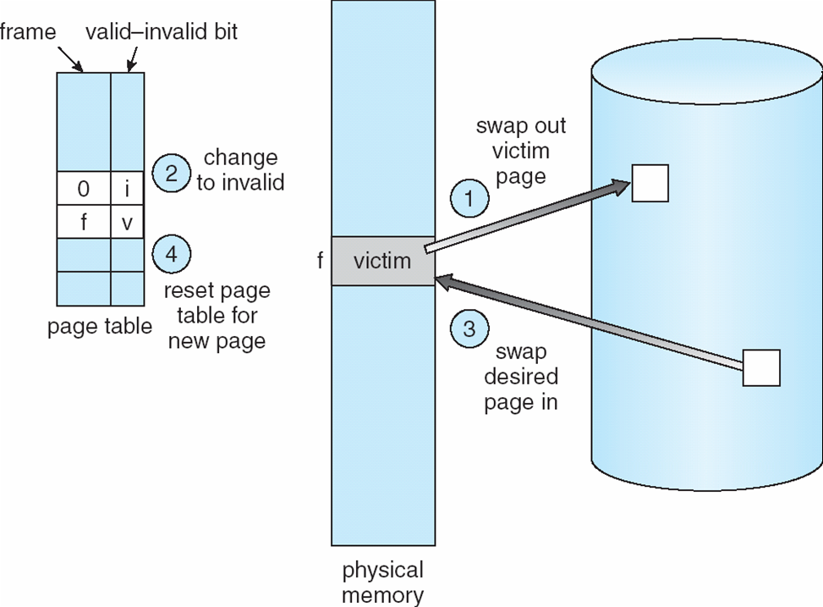
Page Replacement

Slide 27
Page Replacement Algorithms
There are two major requirements to implement a successful demand paging system. We must develop a frame-allocation algorithm and a page-replacement algorithm.
Evaluate algorithm by running it on a particular string of memory references (reference string) and computing the number of page faults on that string.
Reference string can be generated as shown below.
1, 2, 3, 4, 1, 2, 5, 1, 2, 3, 4, 5
So for example, if pages were of size 100 bytes, then the sequence of address requests ( 0100, 0432, 0101, 0612, 0634, 0688, 0132, 0038, 0420 ) would reduce to page requests ( 1, 4, 1, 6, 1, 0, 4 )

Slide 28
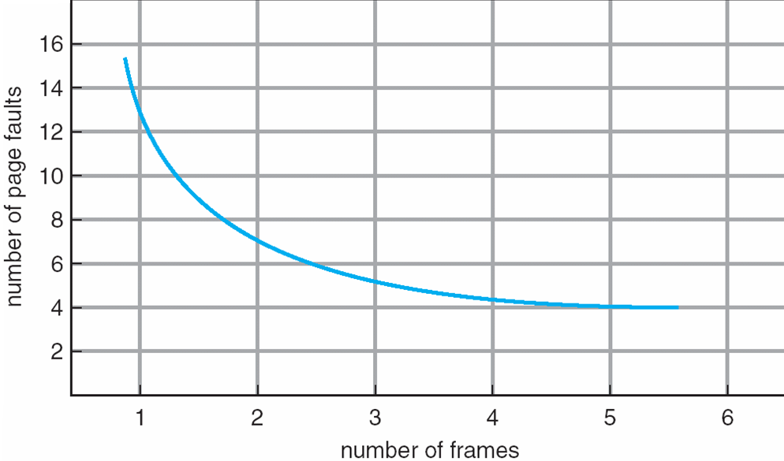
Graph of Page Faults Versus The Number of Frames

Slide 29
First-In-First-Out (FIFO) Algorithm
Reference string: 1, 2, 3, 4, 1, 2, 5, 1, 2, 3, 4, 5
3 frames (3 pages can be in memory at a time per process)
4 frames
Belady’s Anomaly: more frames ⇒ more page faults
1
1
4
5
2
2
1
3
9 page faults
3
3
2
4
1
1
5
4
2
2
1
5
10 page faults
3
3
2
4
4
3

Slide 30
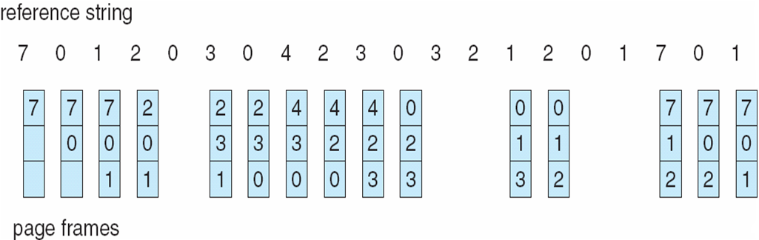
FIFO Page Replacement
In the absence of ANY hardware support, FIFO might be the best available choice.

Slide 31
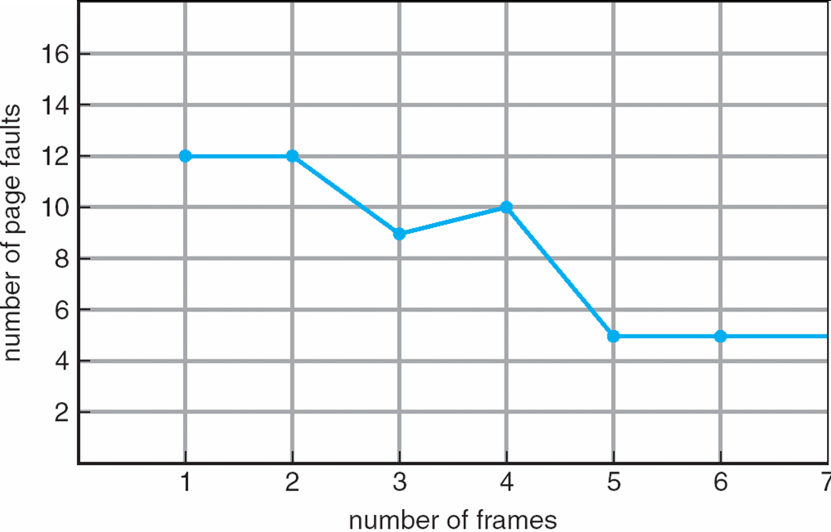
FIFO Illustrating Belady’s Anomaly

Slide 32
Optimal Algorithm
Replace page that will not be used for longest period of time
4 frames example
1, 2, 3, 4, 1, 2, 5, 1, 2, 3, 4, 5
How do you know this?
Used for measuring how well your algorithm performs
1
4
2
6 page faults
3
4
5

Slide 33
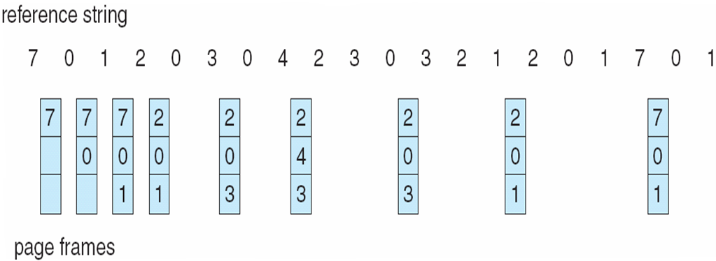
Optimal Page Replacement

Slide 34
Least Recently Used (LRU) Algorithm
Reference string: 1, 2, 3, 4, 1, 2, 5, 1, 2, 3, 4, 5
Resent use can be implemented via Counter or Stack.
Both Counter and stack implementation require hardware support, either for incrementing the counter or for managing the stack, as these operations must be performed for every memory access.
1
1
1
1
5
2
2
2
2
2
3
5
5
4
4
4
4
3
3
3

Slide 35
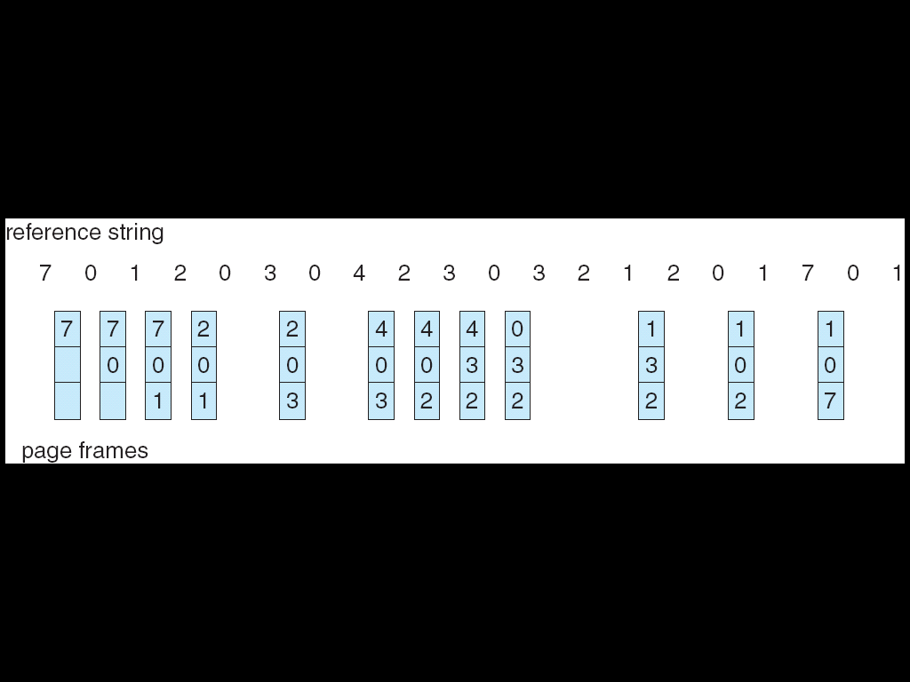
LRU Page Replacement

Slide 36
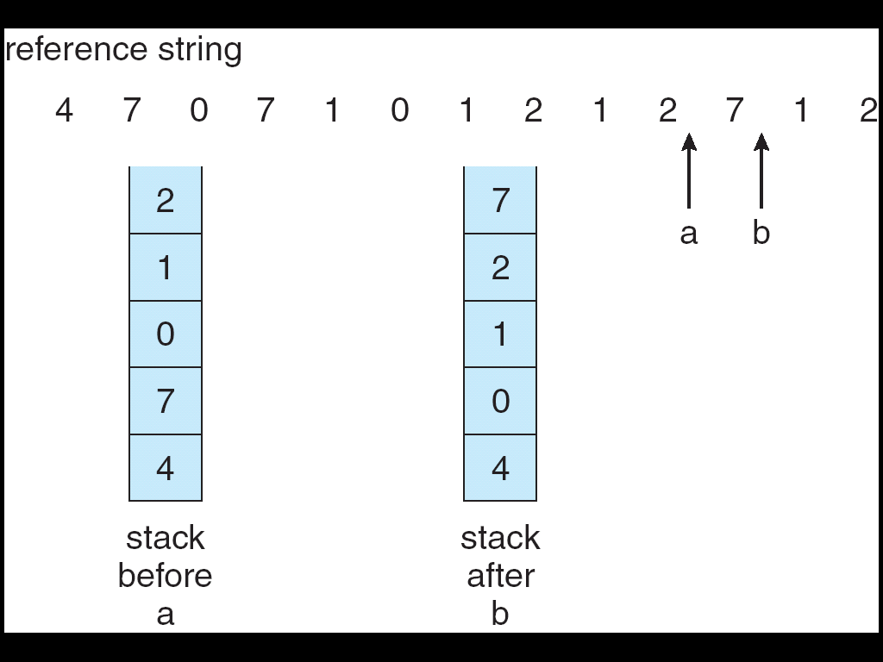
Use Of A Stack to Record The Most Recent Page References

Slide 37
LRU Approximation Algorithms
Unfortunately full implementation of LRU requires hardware support, and few systems provide the full hardware support necessary.
However many systems offer some degree of HW support, enough to approximate LRU fairly well.
In particular, many systems provide a reference bit for every entry in a page table, which is set anytime that page is accessed. Initially all bits are set to zero, and they can also all be cleared at any time.

Slide 38
LRU Approximation : Second-Chance Algorithm
The second chance algorithm is essentially a FIFO, except the reference bit is used to give pages a second chance at staying in the page table.
When a page must be replaced, the page table is scanned in a FIFO ( circular queue ) manner.
If a page is found with its reference bit not set, then that page is selected as the next victim.
If, however, the next page in the FIFO does have its reference bit set, then it is given a second chance:

Slide 39
LRU Approximation : Second-Chance Algorithm
If all reference bits in the table are set, then second chance degrades to FIFO, but also requires a complete search of the table for every page-replacement.
This algorithm is also known as the clock algorithm, from the hands of the clock moving around the circular queue.

Slide 40
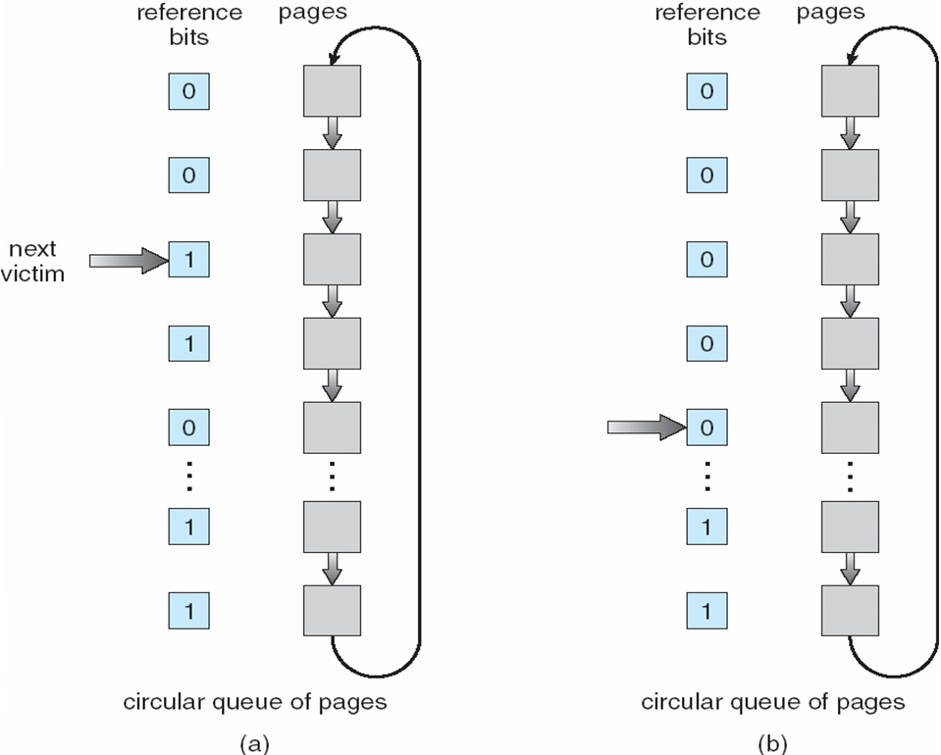
Second-Chance (clock) Page-Replacement Algorithm

Slide 41
LRU Approximation : Enhanced Second-Chance Algorithm
The enhanced second chance algorithm looks at the reference bit and the modify bit ( dirty bit ), and classifies pages into one of four classes:
( 0, 0 ) - Neither recently used nor modified.
( 0, 1 ) - Not recently used, but modified.
( 1, 0 ) - Recently used, but clean.
( 1, 1 ) - Recently used and modified.
This algorithm searches for the first page it can find in the lowest numbered category. I.e. it first makes a pass looking for a ( 0, 0 ), and then if it can't find one, it makes another pass looking for a ( 0, 1 ), etc.

Slide 42
Counting Algorithms
There are several algorithms based on counting the number of references that have been made to a given page, such as:
Least Frequently Used, LFU: Replace the page with the lowest reference count.
Most Frequently Used, MFU: Replace the page with the highest reference count.

Slide 43
Allocation of Frames
Each process needs minimum number of pages
Two major allocation schemes
fixed allocation
priority allocation

Slide 45
Priority Allocation
If process P_{i} generates a page fault,
select for replacement one of its frames
select for replacement a frame from a process with lower priority number

Slide 46
Global vs. Local Allocation
Global replacement – process selects a replacement frame from the set of all frames; one process can take a frame from another
Local replacement – each process selects from only its own set of allocated frames

Slide 47
Thrashing
If a process does not have “enough” pages, the page-fault rate is very high. This leads to:
low CPU utilization
operating system thinks that it needs to increase the degree of multiprogramming
another process added to the system
Thrashing ≡ If the process does not have the number of frames it needs to support pages in active use, it will quickly page-fault. At this point, it must replace some page. However, since all its pages are in active use, it must replace a page that will be needed again right away. Consequently, it quickly faults again, and again, and again, replacing pages that it must bring back in immediately.

Slide 48
Cause of Thrashing
The operating system monitors CPU utilization. If CPU utilization is too low, we increase the degree of multiprogramming.
Now suppose that a process enters a new phase in its execution and needs more frames. It starts faulting and taking frames away from other processes.
These faulting processes must use the paging device to swap pages in and out. As they queue up for the paging device, the ready queue empties. As processes wait for the paging device, CPU utilization decreases.
The CPU scheduler sees the decreasing CPU utilization and increases the degree of multiprogramming as a result.
As a result, CPU utilization drops even further, and the CPU scheduler tries to increase the degree of multiprogramming even more.

Slide 49
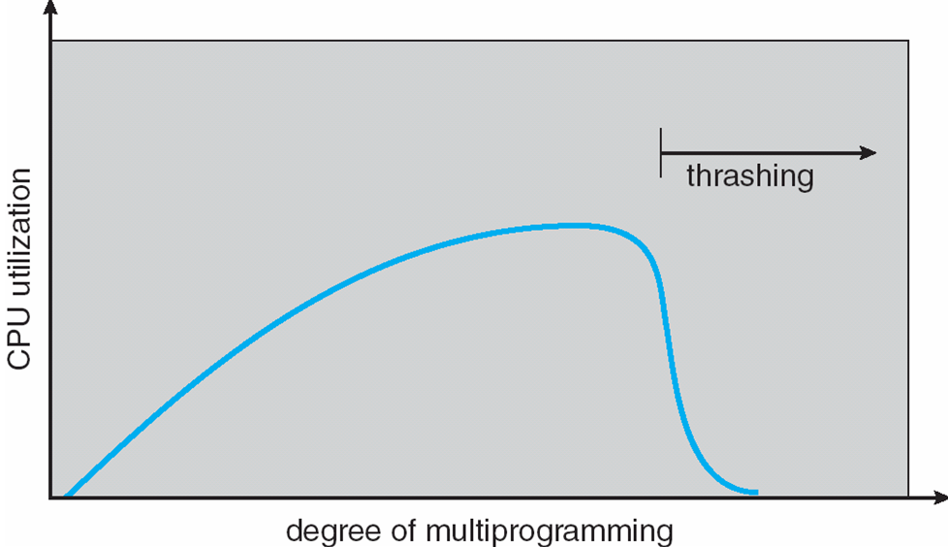
Thrashing has occurred, and system throughput plunges. The page fault rate increases tremendously. As a result, the effective memory-access time increases. No work is getting done, because the processes are spending all their time in paging.

Slide 50
Solution to Thrashing
We can limit the effects of thrashing by using a local replacement algorithm (or priority replacement algorithm). With local replacement, if one process starts thrashing, it cannot steal frames from another process and cause the latter to thrash as well. However, the problem is not entirely solved.

Slide 51
Solution to Thrashing
Provide a process with as many frames as it needs. But how do we know how many frames it “needs”?
Starts by looking at how many frames a process is actually using. This approach defines the locality model of process execution.
The locality model states that, as a process executes, it moves from locality to locality. For example, when a function is called, it defines a new locality with its local and global variables.

Slide 52
Demand Paging and Thrashing
Why does demand paging work? Locality model
Process migrates from one locality to another
Localities may overlap
Why does thrashing occur? Σ size of locality > Total Memory Size M

Slide 53
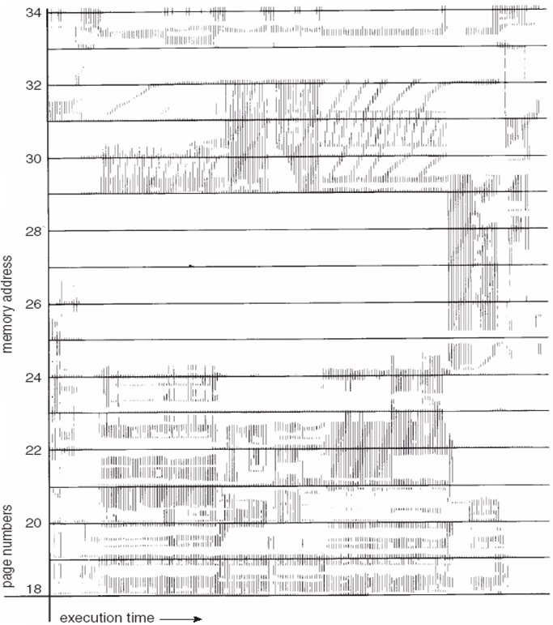
Locality In A Memory-Reference Pattern

Slide 54
Working-Set Model
Δ ≡ working-set window ≡ a fixed number of page references
WSS_{i} (working set of Process P_{i}) = total number of pages referenced in the most recent Δ (varies in time)
if Δ too small will not encompass entire locality
if Δ too large will encompass several localities
if Δ = ∞ ⇒ will encompass entire program
D = Σ WSS_{i} ≡ total demand frames
if D > M ⇒ Thrashing
Policy if D > M, then suspend one of the processes

Slide 55
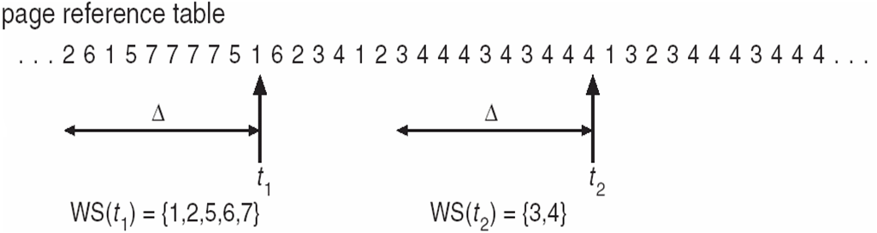
Working-set model

Slide 56
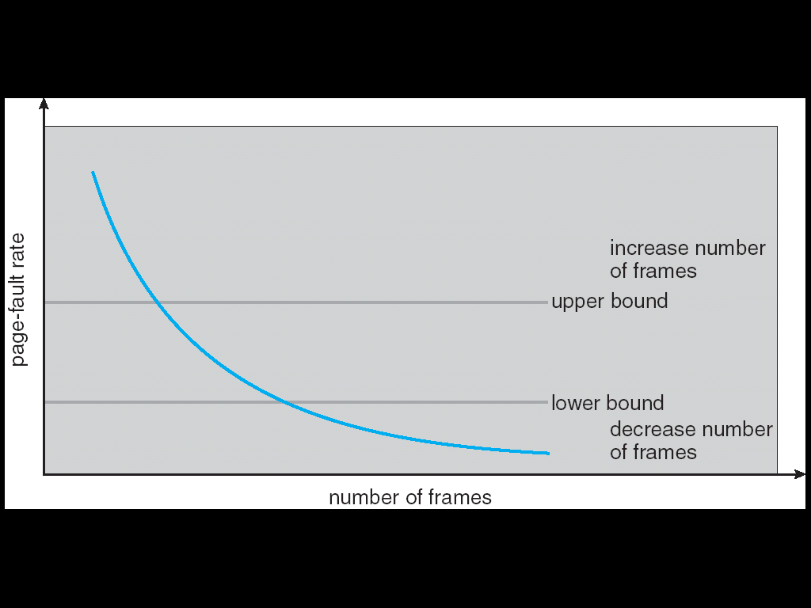
Page-Fault Frequency Scheme
Establish “acceptable” page-fault rate
If actual rate too low, process loses frame
If actual rate too high, process gains frame

Slide 57
Example-1: Suppose R=3,2,4,3,4,2,2,3,4,5,6,7,7,6,5,4,5,6,7,2,1 is a page reference stream, if the window size is 6 and assuming pure demand paging. How may page faults will it cause under the working set algorithm.
Solution: Working set here at any point contains the previous 6 page references (non-distinct).
3 - Working Set = [3], Page fault count = 1
2 - Working Set = [3 2], Page fault count = 2
4 - Working Set = [3 2 4], Page fault count = 3
3 - Working Set = [2 4 3], Page fault count = 3
4 - Working Set = [2 3 4], Page fault count = 3
2 - Working Set = [3 4 2], Page fault count = 3
2 - Working Set = [3 4 2], Page fault count = 3
3 - Working Set = [4 2 3], Page fault count = 3
4 - Working Set = [2 3 4], Page fault count = 3
5 - Working Set = [2 3 4 5], Page fault count = 4
6 - Working Set = [2 3 4 5 6], Page fault count = 5
7 - Working Set = [2 3 4 5 6 7], Page fault count = 6
7 - Working Set = [3 4 5 6 7], Page fault count = 6
6 - Working Set = [4 5 7 6], Page fault count = 6
5 - Working Set = [7 6 5], Page fault count = 6
4 - Working Set = [7 6 5 4], Page fault count = 7
5 - Working Set = [7 6 4 5], Page fault count = 7
6 - Working Set = [7 4 5 6], Page fault count = 7
7 - Working Set = [4 5 6 7], Page fault count = 7
2 - Working Set = [4 5 6 7 2], Page fault count = 8
1 - Working Set = [4 5 6 7 2 1], Page fault count = 9

Slide 58
Example-2: Let the page reference and the working set window be c c d b c e c e a d and 4, respectively. The initial working set at time t=0 contains the pages {a,d,e}, where a was referenced at time t=0, d was referenced at time t=−1, and e was referenced at time t=−2. Determine the total number of page faults and the average number of page frames used by computing the working set at each reference.
Answer: 5 page faults
Avg frame requirement=3.2

